Slide 1
HUMAN SEGMENTATION USING U-NET
PRESENTED BY : T.AARTHY
REG NO : 813821244002
DEPT : COMPUTER SCIENCE AND BUSINESS SYSTEM
COLLEGE : SARANATHAN COLLEGE OF ENGINEERING
NM ID : aarthythamizh830@gmail.com
(au813821244002)
3/21/2024 Annual Review

Slide 2
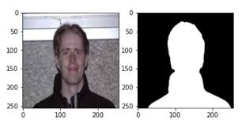
PROJECT TITLE
HUMAN SEGMENATION USING U-NET
3/21/2024 Annual Review

Slide 3


AGENDA
1.PROBLEM STATEMENT
2.PROJECT OVERVIEW
3.WHO ARE THE END USERS?
4.YOUR VALUE AND ITS VALUE PROPOSITION
5.THE WOW IN THE SOLUTION
6.MODELLING
7.RESULTS
3/21/2024 Annual Review

Slide 4

PROBLEM STATEMENT
The Need for an Human segementation using u-net
Human segmentation using U-Net is crucial due to the complex and varied anatomical structures of humans.
The U-Net architecture is adept at capturing detailed local features and understanding global context, making it effective for accurately outlining human subjects even when faced with anatomical complexities..
U-Net's design, with its symmetric contracting and expanding pathways, excels at separating humans from backgrounds, ensuring clear segmentation results.
U-Net is highly effective for accurately and reliably separating humans from their backgrounds in images or videos, even when the conditions are challenging.
This project aims to develop an intelligent system capable of interpreting users' emotional cues and curating playlists that resonate with their feelings, thereby enhancing their music listening experience.
3/21/2024 Annual Review

Slide 5

PROJECT OVERVIEW
How it Works
The U-Net model is trained to precisely identify and separate human figures from images using its advanced feature extraction and skip connection mechanisms. This allows the model to capture intricate local details and understand the broader context, ensuring accurate segmentation of humans even in challenging and complex environments.
Objectives
Make sure that the trained U-Net model performs effectively across a wide range of datasets, different environments, varied lighting situations, and various camera angles. This will allow the model to be applicable and reliable in different fields and real-world scenarios.
Overview
Human segmentation using U-Net utilizes a specialized deep learning framework, U-Net, to precisely identify and separate human figures from images or video footage. Originally designed for biomedical image analysis, U-Net has been modified and extensively applied in various computer vision applications, including the segmentation of human subjects.
Goals
Create a U-Net model that excels at accurately and precisely segmenting humans across different poses and backgrounds, ensuring reliable performance for practical, real-world applications.
3/21/2024 Annual Review

Slide 6

WHO ARE THE END USERS?
The end users of human segmentation using U-Net can vary depending on the specific application and domain. Some potential end users include:
Medical Professionals: Radiologists, doctors, and medical researchers may use human segmentation for applications such as tumor detection, organ segmentation, and disease diagnosis in medical imaging modalities like MRI, CT scans, or X-rays.
Surveillance Agencies: Security personnel, law enforcement agencies, and surveillance operators may utilize human segmentation for monitoring and analyzing video footage in surveillance systems, enabling activities such as crowd monitoring, person tracking, and threat detection.
Entertainment Industry: Film producers, game developers, and virtual reality content creators may employ human segmentation for applications such as character animation, green screen compositing, and motion capture in entertainment productions and interactive experiences.
3/21/2024 Annual Review

Slide 7

YOUR SOLUTION AND ITS VALUE PROPOSITION
HUMAN SEGMENTATION USING U-NET
The U-Net model is proficient at accurately separating humans from images or video footage, making it suitable for diverse applications in areas like healthcare, surveillance, entertainment, and robotics.
Unique Value Proposition
Hierarchical Feature Extraction: The design of U-Net allows for the extraction of hierarchical features, capturing both specific local details and broader contextual information when segmenting humans. This capability enables accurate outlining of human body parts and shapes, even when faced with complex scenes that have busy backgrounds or obstructions.
Generalization Across Domains: U-Net models demonstrate strong generalization across varied datasets, environments, lighting, and camera angles, making them suitable for a wide range of applications and situations. This adaptability and versatility of the model enhance its usability across various industries and applications.
3/21/2024 Annual Review

Slide 8

THE WOW IN YOUR SOLUTION
Highlight the unique features or aspects of your solution that make it stand out from competitors.
U-Net models perform effectively across a variety of datasets, environments, and conditions, making them applicable and useful in different fields and situations.
The U-Net model can be tailored and optimized for deployment on resource-constrained edge devices such as smartphones, drones, or IoT devices.
This compatibility expands the solution's reach to remote or mobile environments, surpassing competitors in accessibility and versatility.
U-Net produces segmentation results that are easy to understand, increasing human confidence and trust in the outcomes.
This clarity is essential for important applications such as medical imaging, enhancing the reliability and usability of the solution compared to other competing methods.
3/21/2024 Annual Review
8

Slide 9
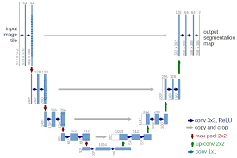
MODELLING
3/21/2024 Annual Review
9

Slide 10
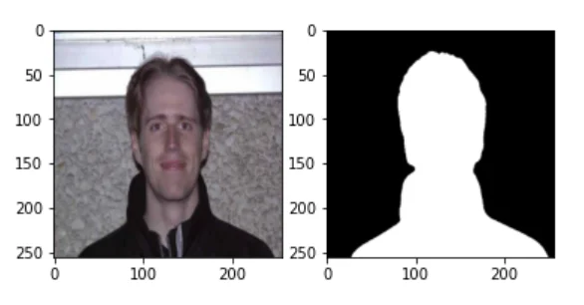
RESULTS
https://github.com/ythraa/TNSDC-Generative-AI.git
3/21/2024 Annual Review
10

